Slide 1


INFERENTIAL
STATISTICS

Slide 2
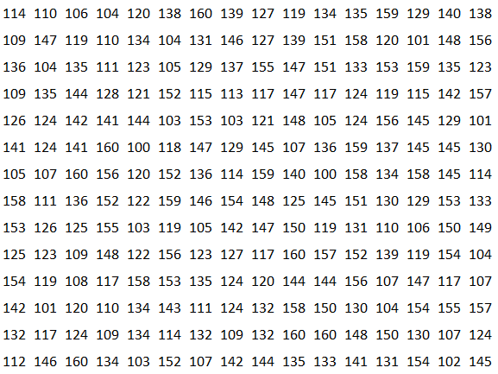
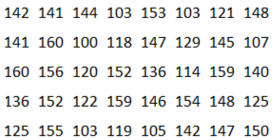
SAMPLE VS POPULATION
Sample statistic
x = 138
Population parameter
u = 140

Slide 3
SAMPLE VS POPULATION
Sample 1
x = 139
Sample 2
x = 143
Sample 3
x = 138

Slide 4
INFERENTIAL STATISTICS
The methods used to determine something about a population on the basis of a sample
Objective: use sample data to obtain results about the whole population
Sample statistics used to estimate population parameters.

Slide 5
WORKING WITH SAMPLES
Sample 1
x = 139
Different samples may have different means
Inherent variability in sample means
Distribution of sample means is called ‘Sampling distribution’
Sample 2
x = 143
Sample 3
x = 138

Slide 6
CENTRAL LIMIT THEOREM
The distribution of sample means (Sampling distribution) is approximately Normal.
Rephrased:
If population has mean mu and variance sigma-squared, then the sampling distribution is approximately normal with mean mu and variance sigma-squared/N (also called standard error), where N is the sample size

Slide 7
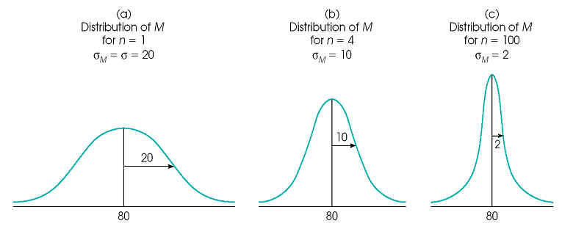
CENTRAL LIMIT THEOREM
As sample size increases, distribution is tighter around the population mean
CLT holds for any distribution - does not depend on the distribution of the population
CLT kicks in after getting a sufficiently large sample*
*’Sufficiently large’ depends on a lot of factors - including the original distribution

Slide 8
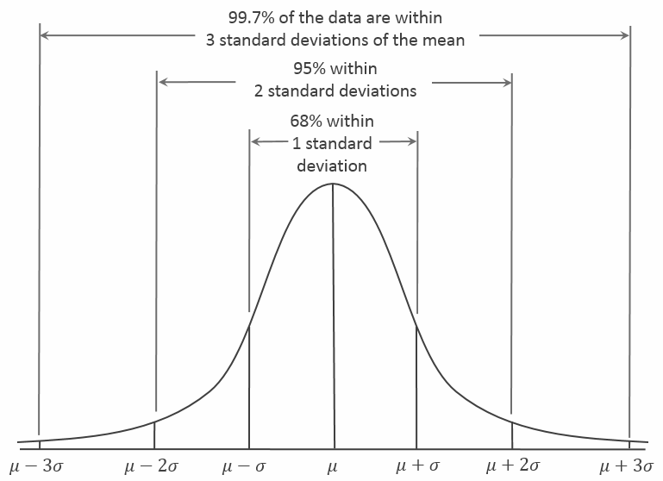
RECALL: NORMAL DISTRIBUTION PROPERTIES

Slide 9
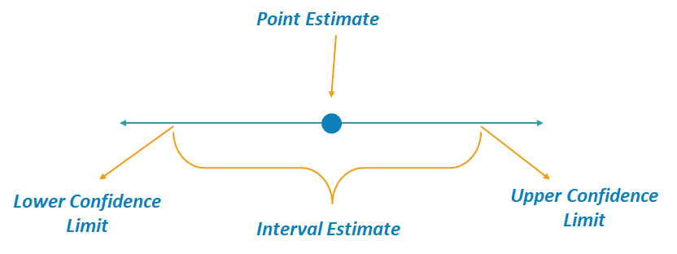
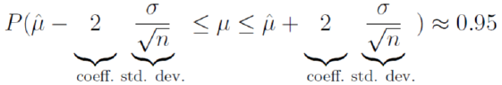
CONFIDENCE INTERVALS
An interval around the sample mean for any sample so that in 95% of samples, the true mean will lie inside this interval.
Leveraging CLT allows for building ‘confidence intervals’ using a single sample
Sample means follow Normal distribution
95% values lie within 2 sigma from mean in Normal distribution

Slide 10
CALCULATING CONFIDENCE INTERVALS
Begin with calculating mean of sample (size N)
Calculate standard error (std dev of sampling distribution) as 𝚺/sqrt(N)
Choose confidence level (e.g. 95%)
Find corresponding Z value ((x-μ)/𝚺)
Margin of error: z * standard error
Confidence interval:
Sample mean +/- Margin of error
E.g.: Interval for 95% confidence

Slide 11
EXERCISE
Mean systolic blood pressure in healthy individuals is 120 mmHg with a standard deviation of 12.
What is the probability that the average systolic blood pressure of a sample of 80 individuals will be more than 130 mmHg?
A sample from 70 individuals had a mean systolic blood pressure as 115. Build a 90% confidence interval for the true mean of the population.

Slide 12
HYPOTHESIS TESTING
Using data to test/validate a hypothesis
Hypothesis: a speculation or theory, that lends itself to further testing and experimentation
Null hypothesis:
the assumption that we wish to test
E.g.: MSG level in Maggi is less than equal to 2.1
E.g.: Average time spent by customer on site is 43 seconds
Alternate hypothesis: simply the inverse of the Null hypothesis
E.g.: average time spend by customer on site is not 43 seconds

Slide 13
HYPOTHESIS TESTING
Flow of a Hypothesis testing process -
State the Null hypothesis in terms of a parameter and estimate sampling distribution
Collect sample data and calculate sample statistic
Evaluate the hypothesis using sample statistic -
Assume that the Null hypothesis is true
How likely are we to observe the data we have at hand, under the Null hypothesis?
If the observed data is very unlikely, then the Null hypothesis data may not be true

Slide 14
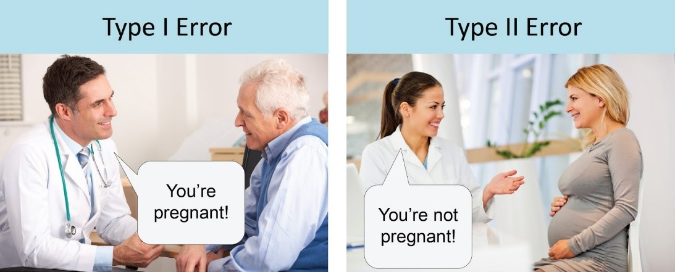
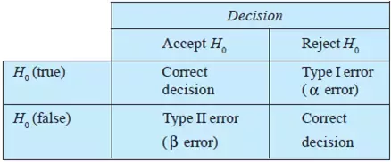
TYPE I vs TYPE II ERRORS
Significance level
The level of Type I error we are willing to accept
Denoted by α
Typically 0.05

Slide 15
p VALUES
Under the Null hypothesis, the probability of observing a value as or more extreme than the sample statistic
Effectively the probability of making a Type I error
p value < α (Significance level) : Reject null hypothesis
p value > α (Significance level) : Fail to reject null hypothesis

Slide 16
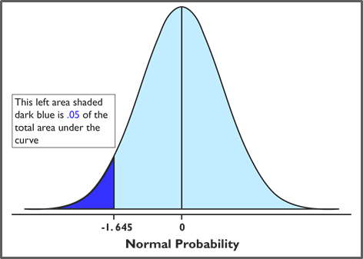
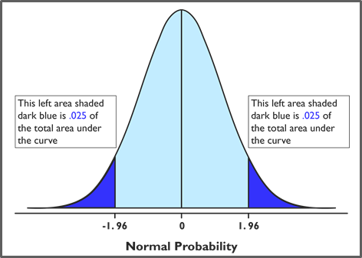
HYPOTHESIS TESTING - One vs. Two tailed test
Example with α = 0.05
One tailed test
Two tailed test
Note: p value calculation is adjusted accordingly

Slide 17

AB TESTING
Very common application of Hypothesis testing in the industry
Controlled experiment:
variants of an element shown to different users
users chosen at random
versions compared to see which performs better
E.g. Click Through Rate for advertising Banner 1 vs. Banner 2
H0: both banners perform the same (CTR1 = CTR2) H1: banner performances are different (CTR1 =/= CTR2)

Slide 18
Statistical Tests
There are many statistical tests available for different kinds of sample structures
T-Test
Z-Test
Chi-Square Test
F-Test
ANOVA

Slide 19
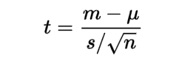
T-Test
Used to Compare means of 2 groups i.e. to identify whether 2 groups are different from one another
Used to understand whether samples from the group are taken from different population.
Usually variances are not known when we apply a T-test
Used primarily in hypothesis testing and AB testing
Assumptions
Sample data is representative of the population
When plotted the data is a normal distribution

Slide 20
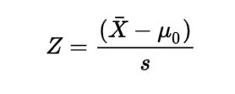
Z-Test
Used to Compare means of 2 groups i.e. to identify whether 2 groups are different from one another
Used when we have enough sample size and variance of the samples are known

Slide 21
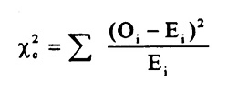
Chi-Squared Test
Used to compare categorical values
How far away your sample is from expected ratio/value of the categorical values

Slide 22

CRISP DM

Slide 23
ANOVA
Analysis of Variance, ANOVA
Compare 3 or more groups
If F statistic > F critical, reject the Null hypothesis
LIMITATIONS
Can not tell you which group is not equal, requires further testing

Slide 24
Why ANOVA ?
When there are 3 or more means being compared, statistical significance can be ascertained by conducting one statistical test, ANOVA, or by repeated t-tests.
Why not conduct repeated t-tests?
Each statistical test is conducted with a specified chance of making a type I–error—the alpha level.
‹#›

Slide 25
Why ANOVA ?
Why not several t-tests?
Imagine we have a design with three groups that have to be compared:
G1, G2, G3
We will have to run several separate t-tests
(one to compare G1 with G2, one to compare G1 with G3, and one to compare G2 with G3)
For every test we use a general α-level of 0.05

Slide 26
α -level=0.05
5% possibility to make Type I error, i.e. rejecting H₀, when H₀ is actually true.
Our scope is too reduce the possibilities to have Type I error
If we were to run 3 separate t-tests to compare G1, G2 and G3, each with a α-level of 0.05, the overall possibility not to make Type I error would be 0.85.
Therefore subtracting that from the overall possibility not to make Type 1 error (1=100%)
1-0.85=0.15
We have 15% of possibilities to make Type 1 error.
15% >> than the usual 5%
We can’t be happy with that!

Slide 27
ONE WAY ANOVA
TYPES OF ANOVA
TWO WAY ANOVA

Slide 28
Why ANOVA ?
The one-way analysis of variance is used to test the claim that three or more population means are equal.
This is an extension of the two independent samples t-test.

Slide 29
How they differ
ANOVA
One-Way ANOVA
Two way ANOVA
One independent variable
Only one ‘p’ value is obtained.
Two independent Variables.
Three different ‘p’ values are obtained.

Slide 30
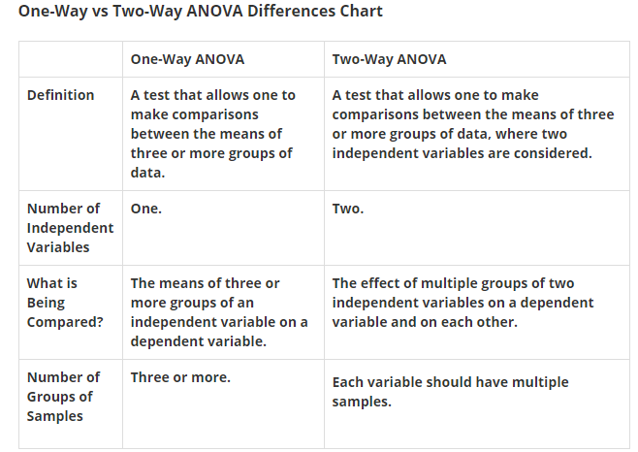

Slide 31
Assumptions of one way ANOVA
The data are randomly sampled and independently chosen from the populations
The variances of each sample are assumed equal.
The residuals are normally distributed.

Slide 32
Computing a one way ANOVA
Here is the basic one-way ANOVA table
Source | SS | df | MS | F | p | F _{crit}
Between
Within
Total

Slide 33
FRONT ROW | MIDDLE ROW | BACK ROW
8 | 13 | 9
8 | 11 | 11
6 | 15 | 14
9 | 14 | 12
10 | 14 | 9
13 | 12 | 11
9 | 11 | 12
11 | 11 | 11
8 | 11 | 9
11 | 11 | 9
10 | 17 | 11
9 | 13 | 11
112 | 153 | 129
1082 | 1993 | 1413
9.33 | 12.75 | 10.75
ΣX_{g}=
= 394
ΣX² =
= 4488
Mean =

Slide 34
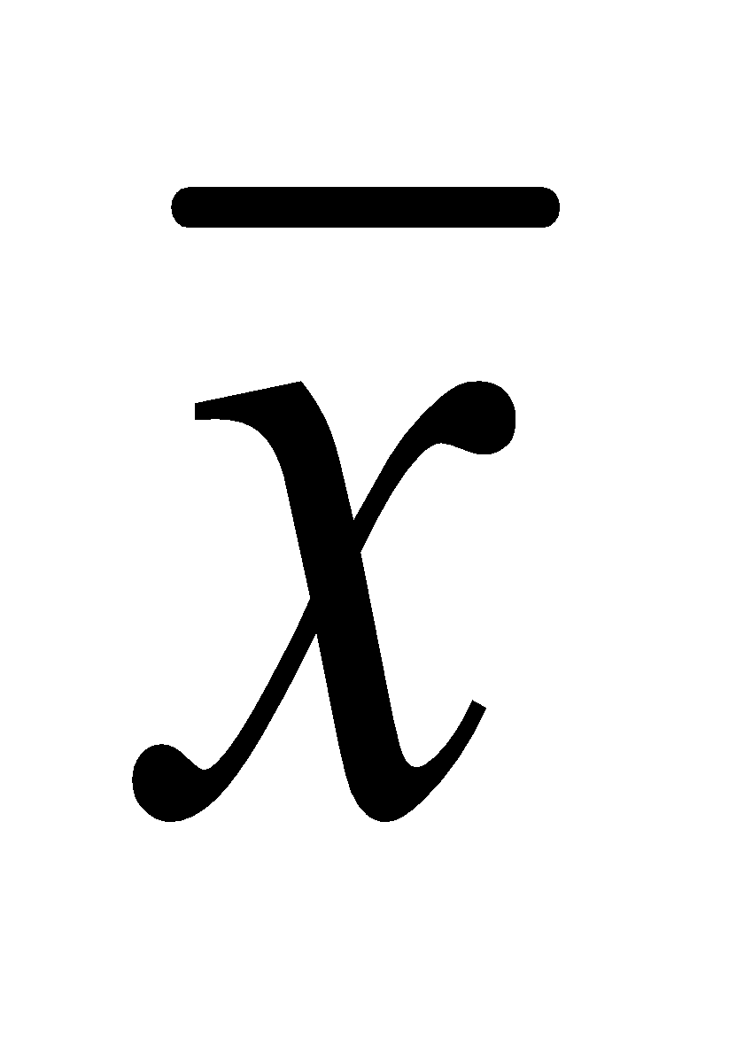
Sum of Squares
• Sum of squares are nothing but sum of squared deviations around the mean i.e. ( X- )²
To calculate the various sums of squares,
we need:
i) the ΣX² (sum of each score squared) in the whole sample
ii) the ΣX (sum of all scores) for the whole sample
iii) and the Group ΣX (sum of scores separately for
each group): represented as ΣX_{g} in as follows

Slide 35
 | FRONT ROW | MIDDLE ROW | BACK ROW | TOTAL
ΣX_{g} | 112 | 153 | 129 | 394
ΣX² | 1082 | 1993 | 1413 | 4488
SS_{total} = ΣX² - (ΣX)²
N
= 4488 - 394² / 36
= 4488 - 4312.11
= 175.88

Slide 36
 | FRONT ROW | MIDDLE ROW | BACK ROW | TOTAL
ΣX_{g} | 112 | 153 | 129 | 394
ΣX² | 1082 | 1993 | 1413 | 4488
SS_{between} = (ΣX_{g})² - (ΣX)²
= 112² + 153² + 129² - (394² / 36)
12
= 4382.83 - 4312.11
= 70.72
n
N

Slide 37
SS_{total} = 175.88
SS_{between} = 70.72
SS_{within} = SS_{total} – SS_{between}
= 175.88 - 70.72
= 105.16

Slide 38
After filling in the sum of squares, we have …
Source | SS | df | MS | F | p | F _{crit}
Between | 70.72
Within | 105.16
Total | 175.88

Slide 39
Degrees fo Freedom
The degrees of freedom, noted in are calculated as N_{i} -1 for the total(Ni is the total number of observations);
number of groups minus one for the between groups;
And for the within error, subtract d.f. for groups from the total degrees of freedom.

Slide 40
So ,
Total degrees of freedom = total number of observations - 1
= 36-1
= 35
Degrees of freedom between groups = Total number of groups – 1
= 3-1
= 2
Degrees freedom within groups = Total d.f – Between group d.f
= 35-2
= 33

Slide 41
Filling in the degrees of freedom gives this …
Source | SS | df | MS | F | p | F _{crit}
Between | 70.72 | 2
Within | 105.16 | 33
Total | 175.88 | 35

Slide 42
Mean Square MS Variance
Why variance estimates are called Mean Squares?
A population variance is equal to the sum of the squared deviations about the mean divided by N.
So the population variance is really the mean of the squared deviations about the mean, or the mean square(d) deviation about the mean. This is why the term mean square is used in place of variance.
It is obtained by dividing each sum of squares with corresponding degrees of freedom.
Σ( X - )²
N

Slide 43
So,
Ms _{between} MS _{within}
= 70.7222 / 2 = 105.1667 / 33
= 35.36 = 3.18
Source | SS | df | MS | F | p | F _{crit}
Between | 70.72 | 2 | 35.36
Within | 105.16 | 33 | 3.18
Total | 175.88 | 35

Slide 44
It is the ratio of MS_{between} and MS_{within}
F = MS(B) / MS(W)
So, F =
35.3611
= 11.10
3.1869
Source | SS | df | MS | F | p | F _{crit}
Between | 70.72 | 2 | 35.36 | 11.10
Within | 105.16 | 33 | 3.18
Total | 175.88 | 35

Slide 45
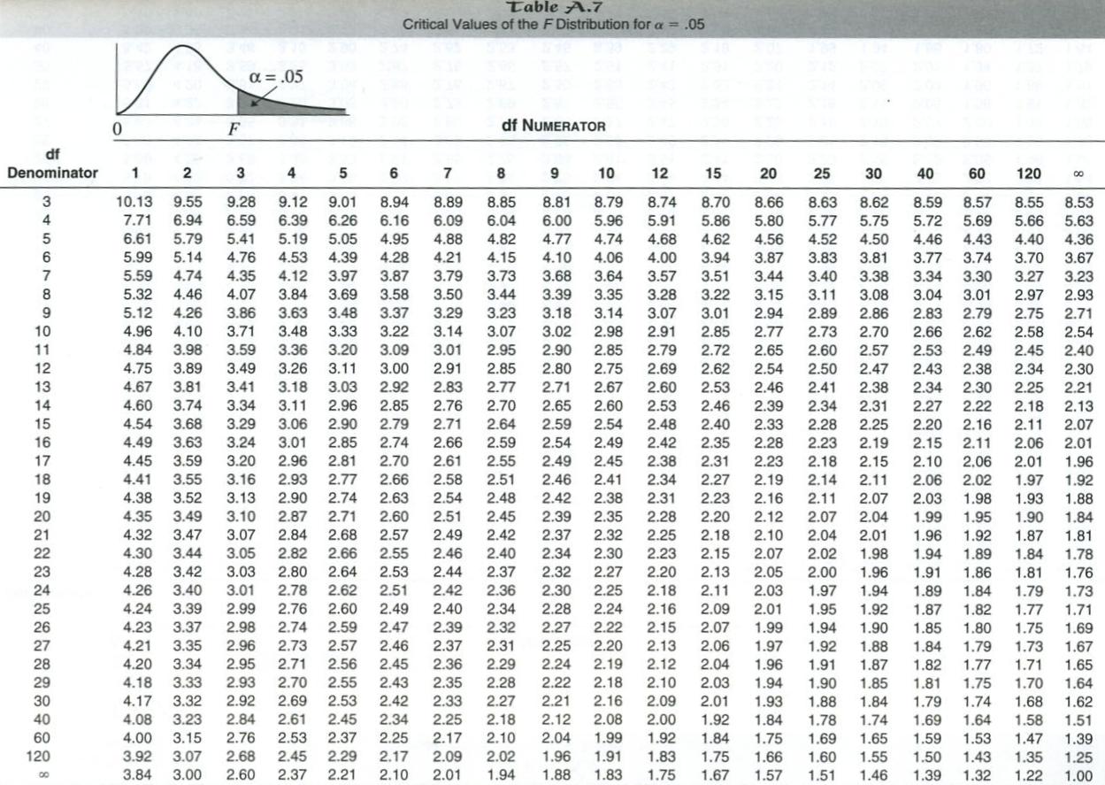





Slide 46
Putting value of F crit to ANOVA table
Source | SS | df | MS | F | p | F _{crit}
Between | 70.72 | 2 | 35.36 | 11.10 | 0.0025 | 3.32
Within | 105.16 | 33 | 3.18
Total | 175.88 | 35

Slide 47
F value and Critical Value
If the F-value ( f )is larger than the f critical value (f crit)
If the p-value is smaller than your chosen alpha level.

Slide 48
One way ANOVA : Interpretation
Our obtained F of 11.10 is greater than the critical F of 3.32 i.e. F_{calculated} > F_{critical} and p- value is less than 0.05
We reject the null hypothesis and accept the alternative hypothesis that there is at least a difference between two of the group means.
If F_{cal} < F_{crit} , We fail to reject the null hypothesis and conclude that there are no significant differences between the group means.

Slide 49
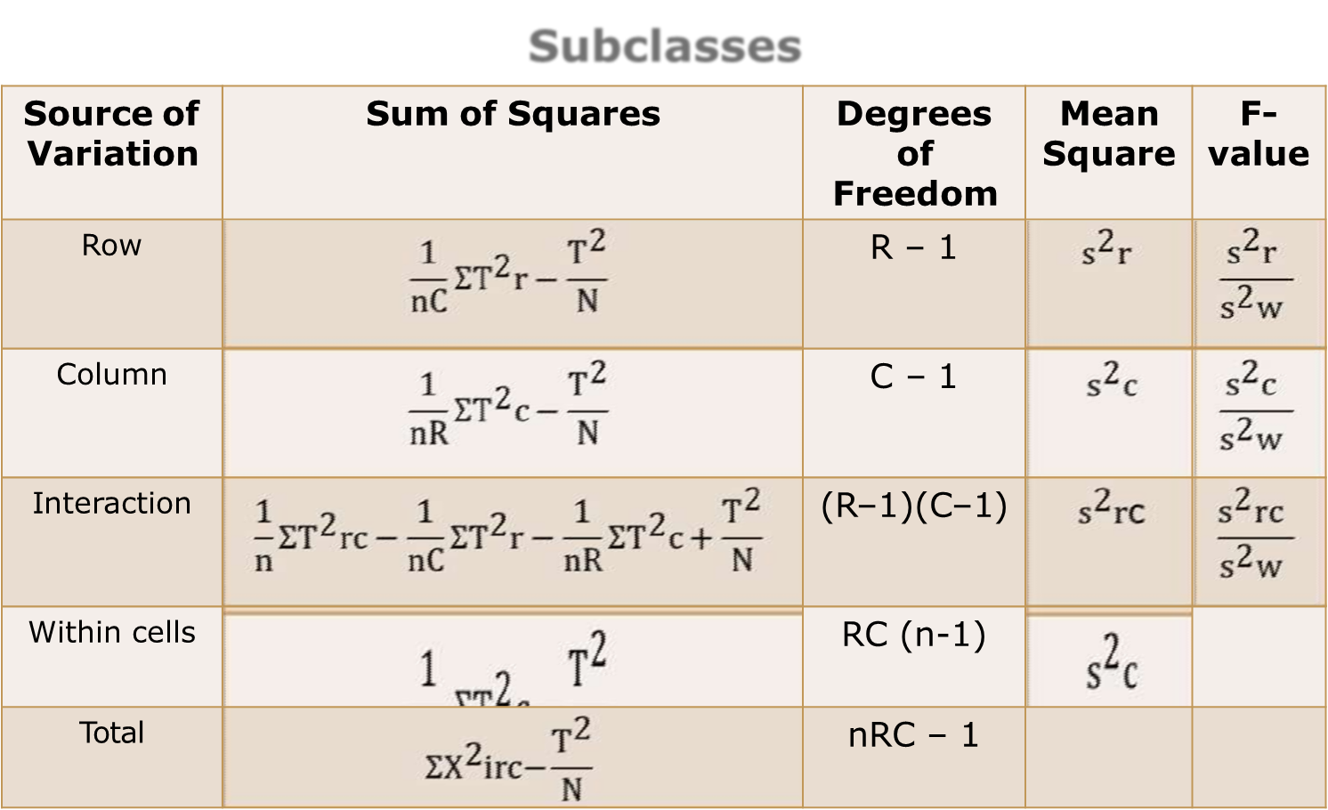
Two way ANOVA : Interpretation
This test is designed for more than two groups of objects studies to see if each group is affected by two different experimental conditions.

Slide 50
Matrix Multiplication
Matrix multiplication is a binary operation whose output is also a matrix when two matrices are multiplied.
In linear algebra, the multiplication of matrices is possible only when the matrices are compatible.
In general, matrix multiplication, unlike arithmetic multiplication, is not commutative, which means the multiplication of matrix A and B, given as AB, cannot be equal to BA, i.e., AB ≠ BA.
Therefore, the order of multiplication for the multiplication of matrices is important.

Slide 51
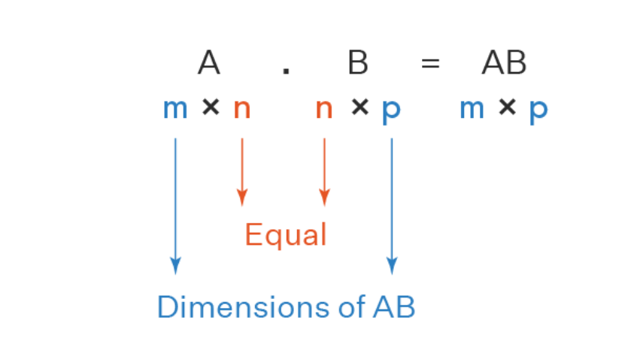
Matrix Multiplication
Two matrices A and B are said to be compatible if the number of columns in A is equal to the number of rows in B. That means if A is a matrix of order m×n and B is a matrix of order n×p, then we can say that matrices A and B are compatible.

Slide 52
Matrix Multiplication
For example,
a) Multiplying a 4 × 3 matrix by a 3 × 4 matrix is valid and it gives a matrix of order 4 × 4
b) 7 × 1 matrix and 1 × 2 matrices are compatible; the product gives a 7 × 2 matrix.
c) Multiplication of a 4 × 3 matrix and 2 × 3 matrix is NOT possible.

Slide 53
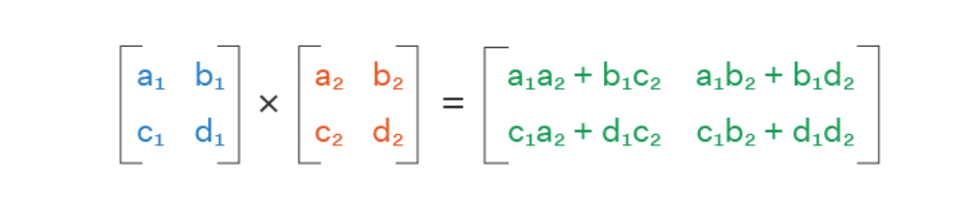
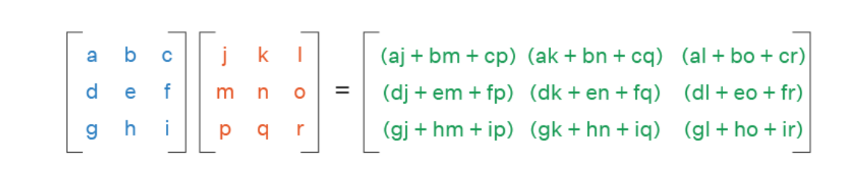
Matrix Multiplication Formula

Slide 54
Correlation
Correlation coefficients are used to measure the strength of the linear relationship between two variables.
A correlation coefficient greater than zero indicates a positive relationship while a value less than zero signifies a negative relationship.
A value of zero indicates no relationship between the two variables being compared.
A negative correlation, or inverse correlation, is a key concept in the creation of diversified portfolios that can better withstand portfolio volatility.
Calculating the correlation coefficient is time-consuming, so data are often plugged into a calculator, computer, or statistics program to find the coefficient.

Slide 55
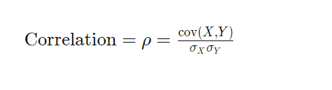
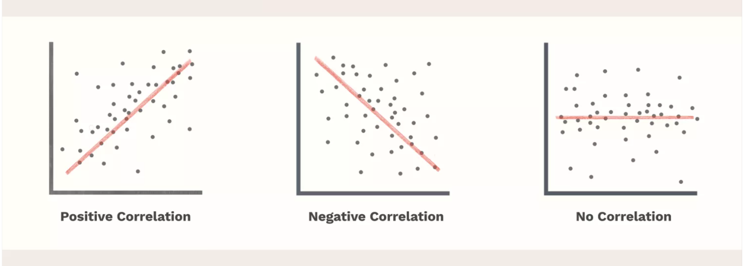
Correlation Coefficient

